Slide 1
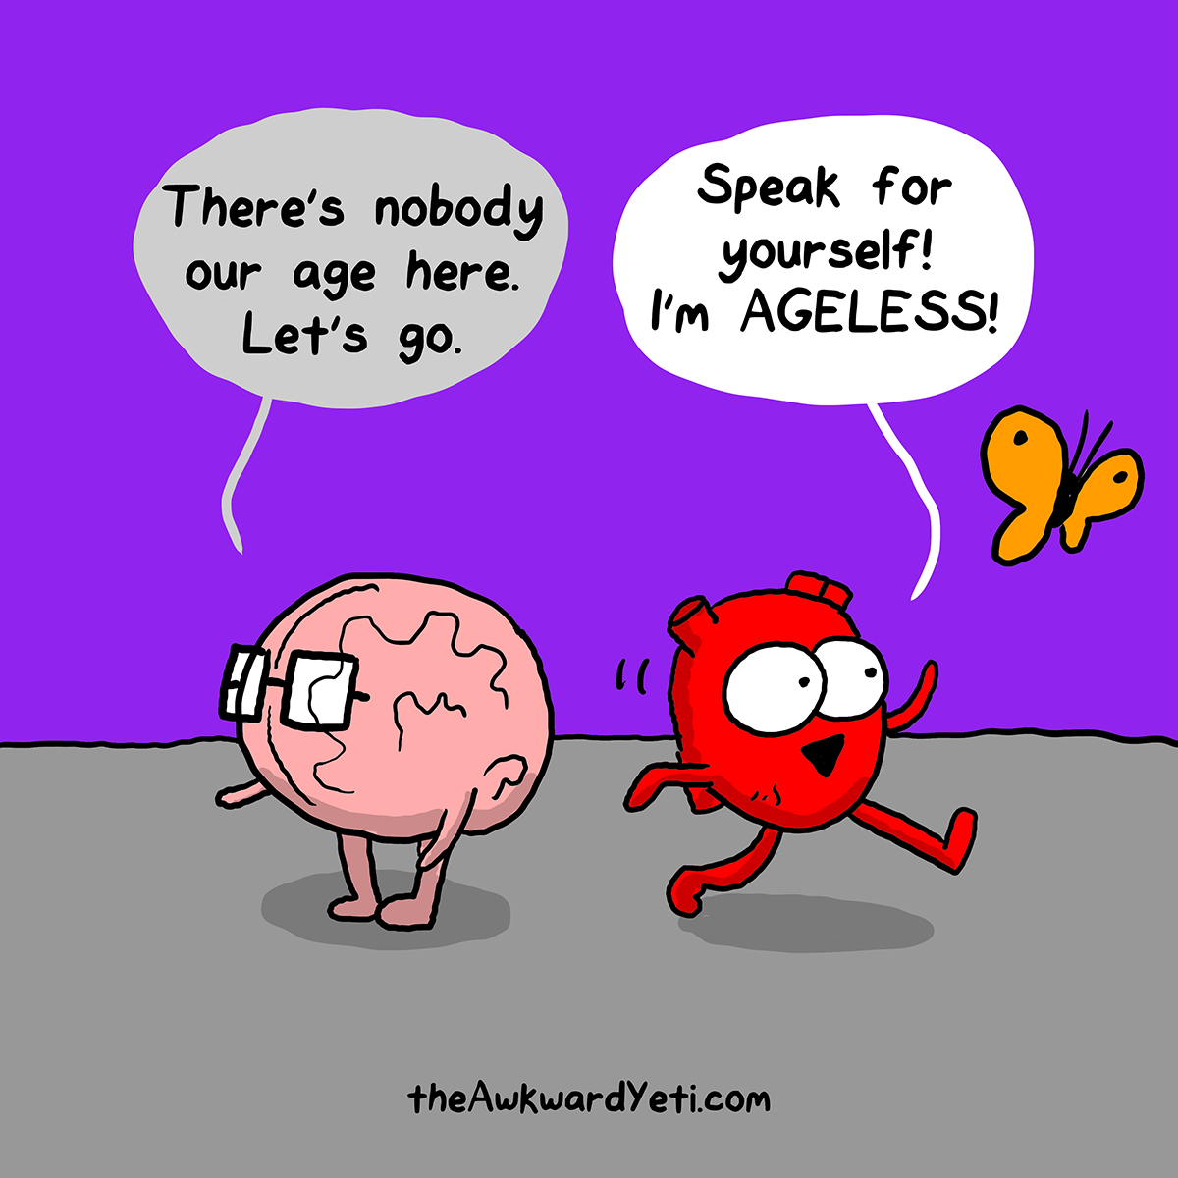

Can I guess your age by looking at your brain?
And dinosaurs!
Notes:
Can I guess your age by looking at your brain? My name is Isabelle, and for my Brainhack School project I am interested in seeing if we can efficiently predict age by looking at the activity of the brain at rest.

Slide 2
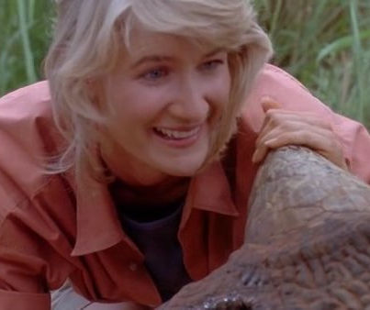
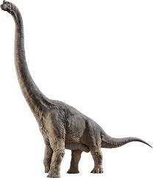
Background
Me:
Ph.D. candidate in forensic psychology
Ontario Tech University
What I could do:
Adapt Matlab scripts
Analyses using SPM and other toolboxes (GUI based)
Several intro to Python workshops
Notes:
Brachiosaurus
Super interested in open science and using more advanced models, data driven models, go beyond traditional stats and learn to code using Python

Slide 3

Background
Adapt Matlab scripts
Analyses using SPM and other toolboxes (GUI based)
Several intro to Python workshops

Slide 4
Background
Adapt Matlab scripts
Analyses using SPM and other toolboxes (GUI based)
Several intro to Python workshops

Slide 5
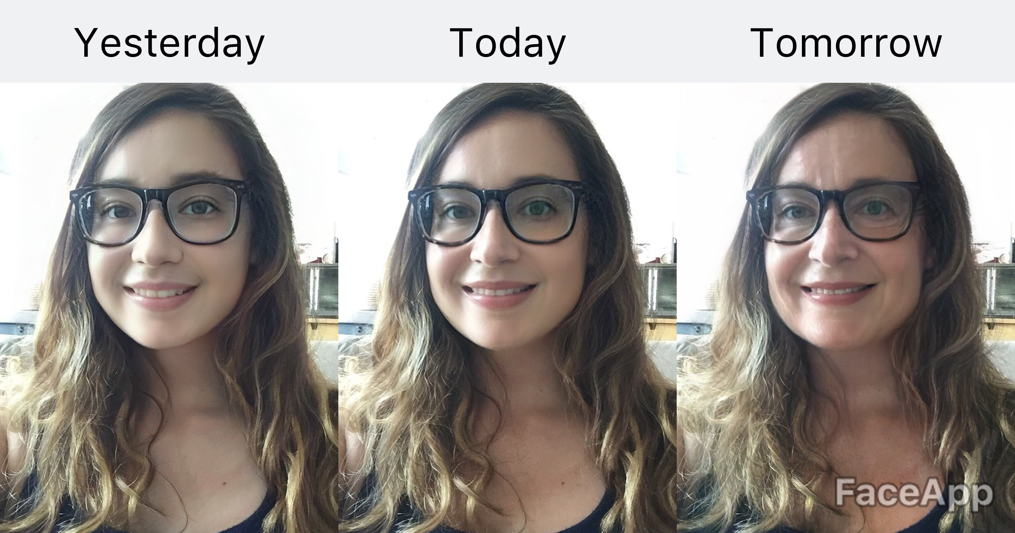
Notes:
This is me today. With applications such as FaceApp, I can predict what I will look like in the future. I definitely look like my mom! FaceApp uses a predictive machine learning algorithm to make those predictions. The model first learns about the different features of the face in individuals of different ages. After learning this information, the model can predict the development of these features through time on faces that it hasn’t seen before..

Slide 6
?
@The Awkward Yeti
Notes:
Jus like our faces, our brain ages. And to be able to predict what it will look like in the future, we first need to know if we can produce an effective predictive model that could efficiently predict the age of a brain by looking at its features.

Slide 7
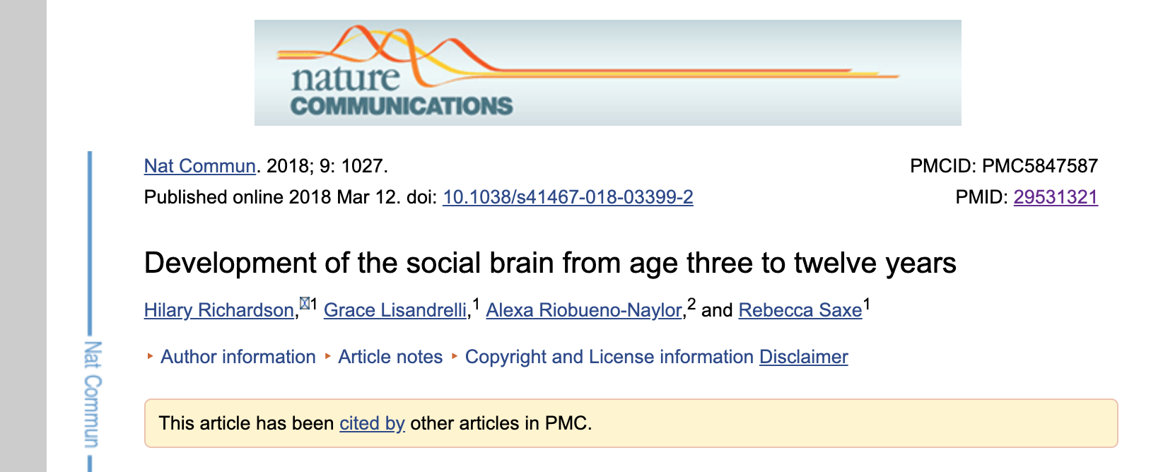
Dataset
Dataset ds000228 from OpenNeuro
155 participants 3 to to 39 years of age
Resting-state data

Slide 8
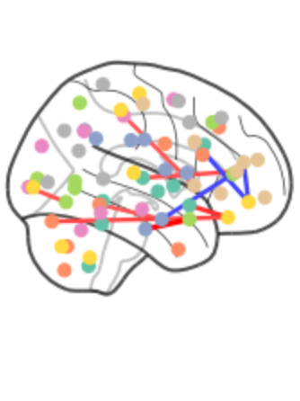
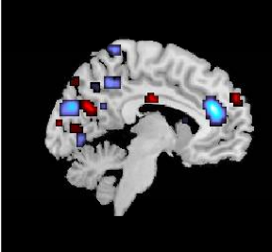
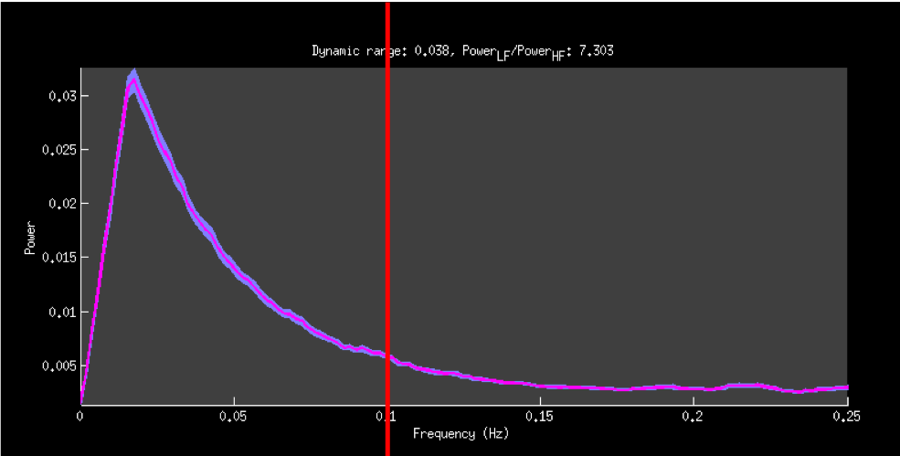
@The Awkward Yeti
fractional Amplitude of Low-frequency Fluctuation: fALFF
Timeseries
Functional connectivity
Notes:
There are many features that can be assessed from the activity of the brain. For this project, I will focus on 3 of those features.
The activity in the different regions of our brain varies through time. We can model this activity by computing activity maps.
It is important to note that this activity is not isolated to each neural region and that activity in different brain regions tends to co-occur with time, making these regions functionally connected. We can model this relationship in activity by computing functional connectivity.
The activity in the brain is captured as an electrical signal that fluctuates in amplitude and frequency. We can assess this fluctuation of the signal through time and brain regions by computing the ratio of the total amplitude of low-frequency activity to that of all other frequencies recorded. This feature is called fractional amplitude of low-frequency fluctuation or fALFF for short.

Slide 9
Support Vector Regressor
Age
Features size:
155 x 10752
Age
Features size:
155 x 2016
Features size:
155 x 64
Age
Notes:
Each of these features give us a different information about brain activity and could have a different capacity to predict age. Hence, I will create 3 support vector regressor algorithms that will evaluate the linear prediction of age for each feature. I will also compare the performance of these models to see which feature is most predictive of age.

Slide 10
Model optimization
SVR with 10 fold cross-validation
Age log transformed
Gridsearch
Validation curve
Feature reduction using PCA

Slide 11

Voting regressor
Age
Notes:
I will also compute a model that will combine the predictive capacity of the 3 features to see if combining them increases our capacity to predict age.

Slide 12
Age
Feature size:
155 x 12832
Notes:
I will also compute a model that will combine the predictive capacity of the 3 features to see if combining them increases our capacity to predict age.

Slide 13
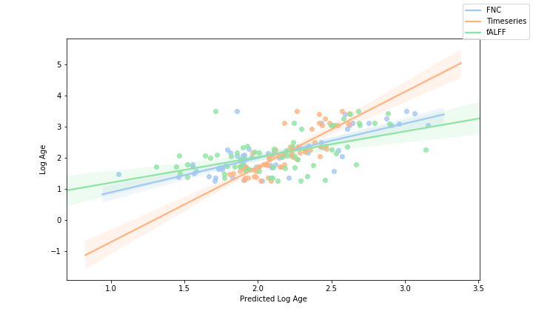
Results

Slide 14
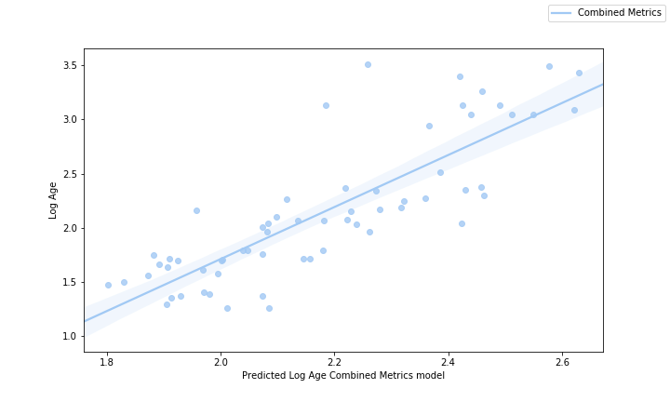
Results

Slide 15

What do I still need to do?
Statistically compare the performance of the 4 models
Identify the features that drive the variable for each model
Clean my Jupyter notebooks

Slide 16

Post Brainhack
Git and Github
Python
Jupyter Notebook
Pandas
Matplotlib
Nilearn
Scikit-learn
Plotly
Machine learning
Model optimization
Ensemble models
Scipy
Numpy
Seaborn

Slide 17

Other things I learned!
There is no straightforward power spectra pipeline for fMRI in Python
Keep in mind the shape of your array!
Google is your friend
Ask your community!

Slide 18
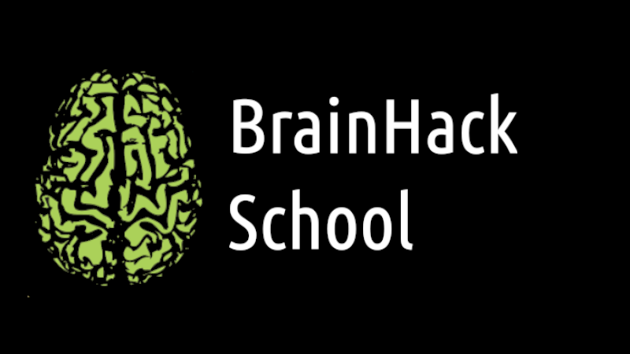
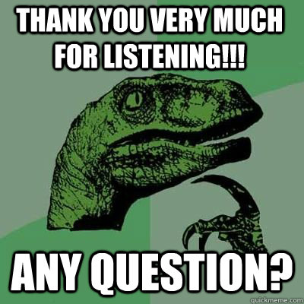


Organisers:
Jean-Baptiste Poline
Pierre Bellec
Nikola Stikov
Tristan Glatard
Special thanks to:
Jacob Vogel
Elizabeth Dupre
Greg Kiar
Pamela Douglas
Matteo Mancini

